Slide 1
UNIT – II
Physical Layer and Media
Chapter 3 Data and Signals
Chapter 4 Digital Transmission
Chapter 5 Analog Transmission
Chapter 6 Bandwidth Utilization: Multiplexing and Spreading

Slide 2
Data and Signals
Analog and Digital
Periodic Analog Signals
Digital Signals
Transmission Impairment
Data Rate Limits
Performance

Slide 3
Analog and Digital
To be transmitted, data must be transformed to electric/electromagnetic signals
Data can be analog or digital. Analog data are continuous and take continuous values (e.g., an analog clock). Digital data have discrete states and take on discrete values (e.g., an digital clock).
Like the data, signals can be analog or digital. Analog signals can have an infinite number of values in a range; digital signals can have only a limited number of values.

Slide 4


Slide 5
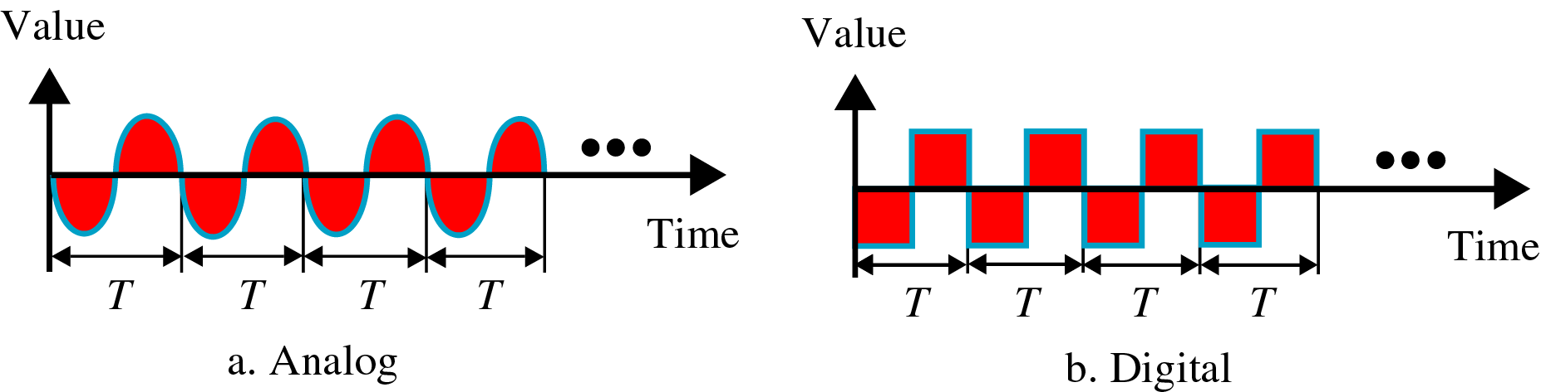
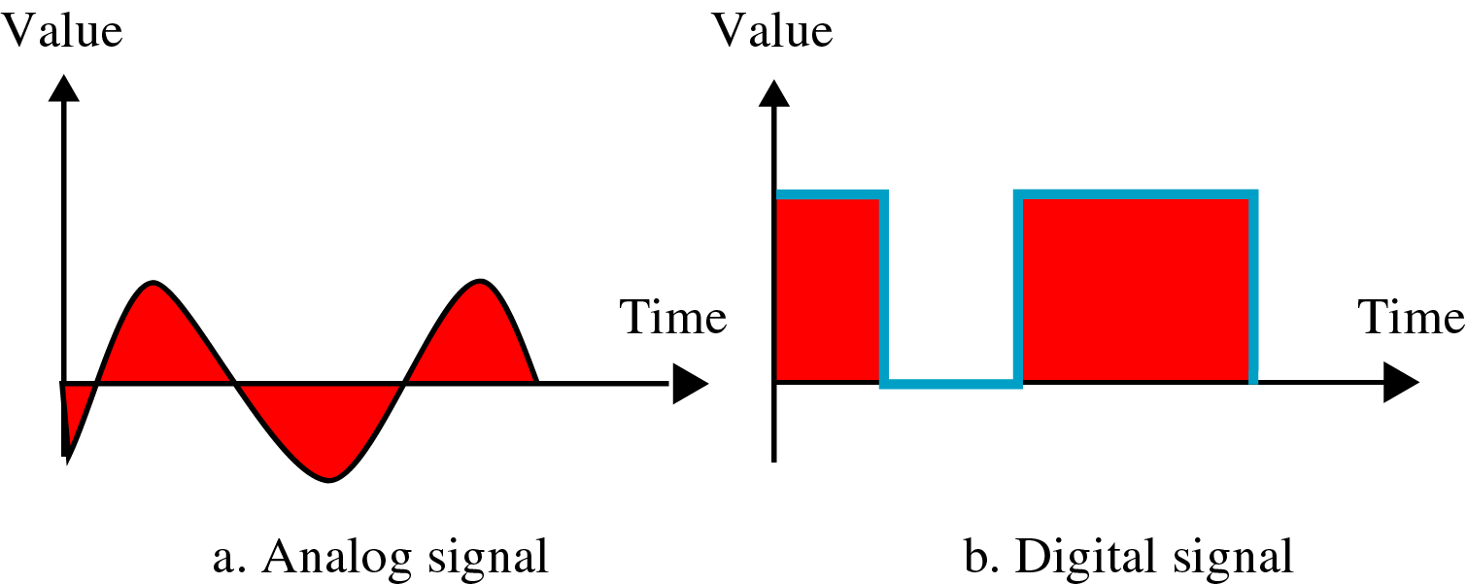
Periodic and Nonperiodic Signals
Both analog and digital signals can take one of two forms: periodic or nonperiodic (aperiodic).
A periodic signal completes a pattern within a measurable time frame, called a period, and repeats that pattern over subsequent identical periods.
The completion of one full pattern is called a cycle.
A nonperiodic signal changes without exhibiting a pattern or cycle that repeats over time.
In data communication, we commonly use periodic analog signals and nonperiodic digital signals.

Slide 6
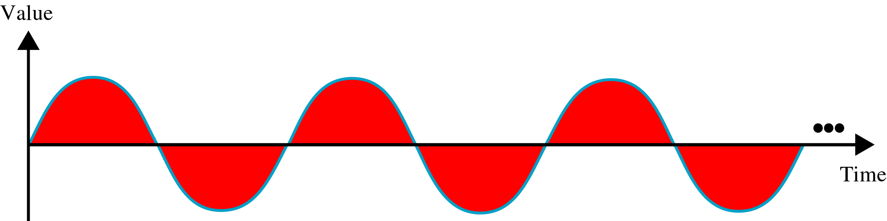
Periodic Analog Signals
Periodic analog signals can be classified as simple or composite.
A simple periodic analog signal, a sine wave, cannot be decomposed into simpler signals.
A composite periodic analog signal is composed of multiple sine waves
Sine wave can be represented by three parameters:
  peak amplitude
  frequency (period)
  phase

Slide 7

Peak Amplitude
The peak amplitude of a signal is the absolute value of its highest intensity. For electrical signals, peak amplitude is normally measured in volts.

Slide 8

Period and Frequency
Period refers to the amount of time, in seconds, a signal needs to complete 1 cycle. Frequency refers to the number of periods in 1 s. Frequency and period are the inverse of each other (f =1/T and T=1/f).

Slide 9

Units of period and frequency

Slide 10
Example
Express a period of 100 ms in microseconds, and express the corresponding frequency in kilohertz.
we know the equivalent of 1 ms. We make the following substitutions:
100 ms = 100 × 10⁻³ s = 100 × 10⁻³ × 10⁶ μs = 10⁵ μs
Now we use the inverse relationship to find the frequency, changing hertz to kilohertz
100 ms = 100 × 10⁻³ s = 10⁻¹ s
f = 1/10⁻¹ Hz = 10 × 10⁻³ KHz = 10⁻² KHz

Slide 11
More About Frequency
Another way to look frequency
  Frequency is a measurement of the rate of changes with respect to time.
  Change in a short span of time means high frequency
  Change over a long span of time means low frequency
Two extremes
  No change at all ⇒ zero frequency
  Instantaneous changes ⇒ infinite frequency

Slide 12

Phase
Phase describes the position of the waveform relative to time 0.
Phase is measured in degrees or radians.

Slide 13
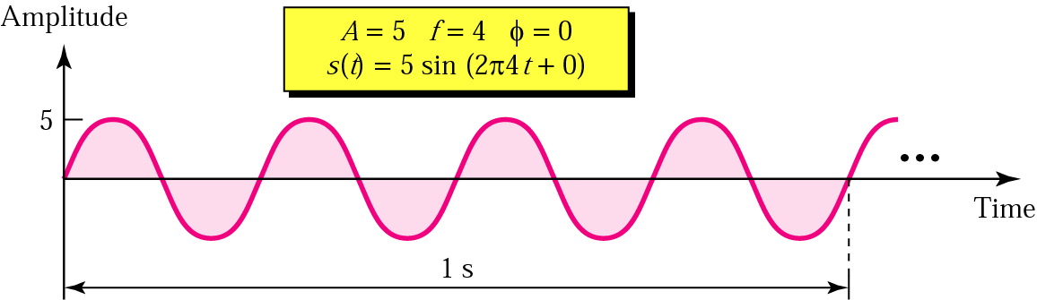
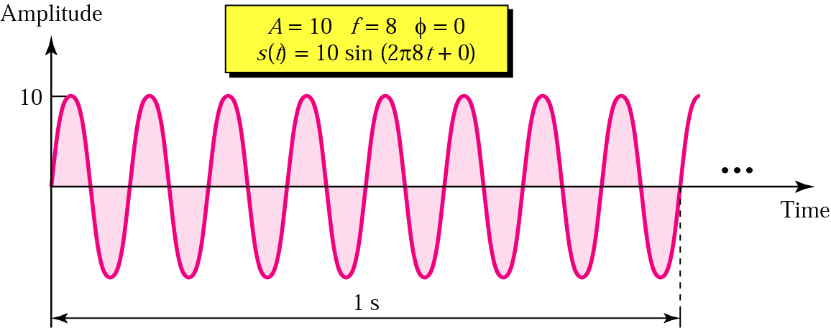
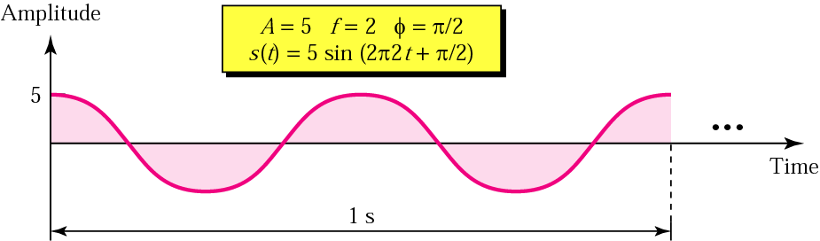
Sinewave Examples

Slide 14
Example
A sine wave is offset one-sixth of a cycle with respect to time zero. What is its phase in degrees and radians?
We know that one complete cycle is 360 degrees.
Therefore, 1/6 cycle is
(1/6) 360 = 60 degrees = 60 x 2π /360 rad = 1.046 rad

Slide 15

Wavelength(λ)
Another characteristic of a signal traveling through a transmission medium
Binds the period or the frequency of a simple sine wave to the propagation speed of the medium
While the frequency of a signal is independent of the medium, the wavelength depends on both the frequency and the medium.
The wavelength is the distance a simple signal can travel in one period, normally measured in micrometers.
Wavelength = propagation speed x period
= propagation speed/frequency

Slide 16

Time and Frequency Domains
A complete sine wave in the time domain can be represented by one single spike in the frequency domain

Slide 17

Example
Time domain and frequency domain of three sine waves with frequencies 0, 8, 16

Slide 18
Composite Signals
A single-frequency sine wave is not useful in data communications; we need to send a composite signal, a signal made of many simple sine waves.
According to Fourier analysis, any composite signal is a combination of simple sine waves with different frequencies, amplitudes, and phases.
A composite signal can be periodic or nonperiodic.
If the composite signal is periodic, the decomposition gives a series of signals with discrete frequencies; if the composite signal is nonperiodic, the decomposition gives a combination of sine waves with continuous frequencies.
When we change one or more characteristics of a single-frequency signal over a period, it becomes a composite signal made of many frequencies

Slide 19


Composite Periodic Signal

Slide 20

Composite Nonperiodic Signal

Slide 21

Bandwidth
The bandwidth of a composite signal is the difference between the highest and the lowest frequencies contained in that signal

Slide 22

Digital Signals
Information can also be represented by a digital signal.
A digital signal can have more than two levels. In this case, we can send more than 1 bit for each level.
In general, if a signal has L levels, each level needs log₂L bits.

Slide 23

Bit Rate
Most digital signals are nonperiodic, and thus period and frequency are not appropriate characteristics.
Bit rate – used to describe digital signals.
Bit rate is the number of bits sent in 1s, expressed in bits per second (bps)
Assume we need to download text documents at the rate of 100 pages per minute. What is the required bit rate of the channel?
Solution
A page is an average of 24 lines with 80 characters in each line. If we assume that one character requires 8 bits, the bit rate is

Slide 24
Bit Length
Similar to the wavelength for an analog signal, we can define for a digital signal: the bit length.
Bit length is the distance one bit occupies on the transmission medium.
Bit length = propagation speed X bit duration

Slide 25

Digital Signal as a Composite Analog Signal
Based on Fourier analysis, a digital signal is a composite analog signal.

Slide 26

Transmission of Digital Signals
A digital signal, periodic or nonperiodic, is a composite analog signal with an infinite bandwidth.
We can transmit a digital signal by using one of two different approaches: Baseband transmission - Sending a digital signal over a channel without changing it into an analog signal, or broadband transmission – using modulation.
Baseband transmission

Slide 27

Baseband transmission requires a low-pass channel, a channel with a bandwidth that starts from zero.
The below fig. shows two low-pass channels: one with a narrow bandwidth and the other with a wide bandwidth.
We need to remember that a low-pass channel with infinite bandwidth is ideal, but we cannot have such a channel in real life.

Slide 28

Low-Pass Channel with Wide Bandwidth
Baseband transmission of a digital signal that preserves the shape of the digital signal is possible only if we have a low-pass channel with infinite or very wide bandwidth

Slide 29

Low-Pass Channel with Limited Bandwidth
In a low-pass channel with limited bandwidth, we approximate the digital signal with an analog signal.
Rough approximation
Rough approximation of a digital signal using the first harmonic for worst case

Slide 30

Better approximation: to make the shape of the analog signal look more like that of a digital signal, we need to add more harmonics of the frequencies.
Simulating a digital signal with three first harmonics

Slide 31

Bandwidth Requirement
In baseband transmission, the required bandwidth is proportional to the bit rate; if we need to send bits faster, we need more bandwidth

Slide 32

Broadband Transmission (Using Modulation)
Means changing the digital signal to an analog signal for transmission.
Modulation allows us to use a bandpass channel – a channel with a bandwidth that does not start from zero.
This type of channel is more available than a low-pass channel.
If the available channel is a bandpass channel, we cannot send the digital signal directly to the channel; we need to convert the digital signal to an analog signal before transmission.

Slide 33

In the fig., a digital signal is converted to a composite analog signal. At the receiver, the received analog signal is converted to digital, and the result is a replica of what has been sent.
Modulation of a digital signal for transmission on a bandpass channel

Slide 34

Transmission Impairment
Signals travel through transmission media, which are not perfect. The imperfection causes signal impairment.
This means that the signal at the beginning of the medium is not the same as the signal at the end of the medium.
Three causes of impairment are

Slide 35

Attenuation
Means a loss of energy.
Some of the electrical energy in the signal is converted to heat.
To compensate for this loss, amplifiers are used to amplify the signal.

Slide 36


Decibel:
To show that a signal has lost or gained strength, decibel is used.
Note that the decibel is negative if a signal is attenuated and positive if a signal is amplified.
Example1: Suppose a signal travels through a transmission medium and its power is reduced to one-half. This means that P₂ is (1/2)P₁. In this case, the attenuation (loss of power) can be calculated as
Example2:

Slide 37

Distortion
The signal changes its form or shape.
Distortion can occur in composite signal made of different frequencies. Each signal component has its own propagation speed through a medium and, therefore, its own delay in arriving at the final destination.
Differences in delay may cause a difference in phase if the delay is not exactly the same as the period duration.

Slide 38

Noise
Several types of noises, such as thermal noise, induced noise, crosstalk, and impulse noise, may corrupt the signal

Slide 39


Signal-to-Noise Ratio (SNR)
SNR = average signal power/average noise power
A high SNR means the signal is less corrupted by noise; a low SNR means the signal is more corrupted by noise.
SNR_{dB} = 10 log₁₀ SNR
Example: The power of a signal is 10 mW and the power of the noise is 1 μW; what are the values of SNR and SNR_{dB} ?
Solution:

Slide 40
Data Rate Limits
A very important consideration in data communications is how fast we can send data, in bits per second, over a channel.
Data rate depends on three factors:
  Bandwidth available
  Level of the signals we use
  Quality of the channel (the noise level)
Two theoretical formulas were developed to calculate the data rate: one by Nyquist, and another by Shannon.
Noiseless channel: by Nyquist
  BitRate = 2 * Bandwidth * log₂L
  where bandwidth is the bandwidth of the channel, L is the number of signal levels used to represent data, and BitRate is the bit rate in bits per second.
  Increasing the levels of a signal may reduce the reliability of the system.

Slide 41
Example1: Consider a noiseless channel with a bandwidth of 3000 Hz transmitting a signal with two signal levels. The maximum bit rate can be calculated as
Bit Rate = 2 × 3000 × log₂ 2 = 6000 bps
Example2: Consider the same noiseless channel, transmitting a signal with four signal levels (for each level, we send two bits). The maximum bit rate can be calculated as:
Bit Rate = 2 x 3000 x log₂ 4 = 12,000 bps
In reality, we cannot have a noiseless channel; the channel is always noisy.
Noisy channel: by Shannon
  Capacity = Bandwidth * log₂(1 + SNR)
  where bandwidth is the bandwidth of the channel, SNR is the signal-to-noise ratio, and capacity is the capacity of the channel in bits per second.

Slide 42
We cannot achieve a data rate higher than the capacity of the channel.
Example3: Consider an extremely noisy channel in which the value of the signal-to-noise ratio is almost zero. In other words, the noise is so strong that the signal is faint. For this channel the capacity is calculated as
C = B log₂ (1 + SNR) = B log₂ (1 + 0) = B log₂ (1) = B × 0 = 0
Example4: We can calculate the theoretical highest bit rate of a regular telephone line. A telephone line normally has a bandwidth of 3000 Hz (300 Hz to 3300 Hz). The signal-to-noise ratio is usually 3162. For this channel the capacity is calculated as
C = B log₂ (1 + SNR) = 3000 log₂ (1 + 3162) = 3000 log₂ (3163)
C = 3000 × 11.62 = 34,860 bps

Slide 43
Using Both Limits
The Shannon capacity gives us the upper limit; the Nyquist formula tells us how many signal levels we need.
Example: We have a channel with a 1 MHz bandwidth. The SNR for this channel is 63; what is the appropriate bit rate and signal level?
  First, we use the Shannon formula to find our upper limit
  C = B log₂ (1 + SNR) = 106 log₂ (1 + 63)
  = 106 log₂ (64) = 6 Mbps
  Then we use the Nyquist formula to find the number of signal levels
  4 Mbps = 2 × 1 MHz × log₂ L ➔ L = 4

Slide 44
Performance
One important issue in networking is the performance of the network.
Bandwidth
  One of the performance measuring parameters.
  The term can be used in two different contexts: bandwidth in hertz and bandwidth in bits per second.
  Bandwidth in hertz is the range of frequencies in a composite signal or the range of frequencies a channel can pass.
  Bandwidth in bits per second refers to the number of bits per second that a channel, a link, or even a network can transmit.
  There is an explicit relationship between the bandwidth in hertz and bandwidth in bits per seconds. Basically, an increase in bandwidth in hertz means an increase in bandwidth in bits per second.
Throughput
  is a measure of how fast we can actually send data through a network

Slide 45

  Example: A network with bandwidth of 10 Mbps can pass only an average of 12,000 frames per minute with each frame carrying an average of 10,000 bits. What is the throughput of this network?
  the throughput is almost one-fifth of the bandwidth in this case.
Latency (Delay)
  defines how long it takes for an entire message to completely arrive at the destination from the time the first bit is sent out from the source.
  Latency = propagation time + transmission time + queuing time + processing delay
  Propagation time measures the time required for a bit to travel from the source to the destination.
  - Propagation time = Distance/Propagation speed
  Transmission time is the time required for transmission of a message. It depends on the size of the message and the bandwidth of the channel.

Slide 46
  - Transmission time = Message size/Bandwidth
  Queuing time is the time needed for each intermediate or end device to hold the message before it can be processed. It is not a fixed factor; it changes with the load imposed on the network.
Jitter
- it is a problem if different packets of data encounter different delays and the application using the data at the receiver site is time-sensitive (e.g., audio and video data)

Slide 47


Bandwidth-Delay Product
The bandwidth-delay product defines the number of bits that can fill the link.
Bandwidth-delay product concept

